Slide 1
Optimized Warehouse Management Of Perishable Goods For A Food Delivery Company

Slide 2
Proposed Solution
The proposed solution will allow the admin to login and manage different stores present at various regions of the country.
The data collected on each store is helpful to determine the demand of particular perishable products in that region.
The admin can add, update or remove store, supplier and store manager in the system.The store manager will be able to have access to all the products present in the store.
The store manager will be responsible to maintain records of new products and orders made. All the data of the sales is collected and stored in database as per weekly orders and sales done. Later, the machine learning model is used to check which products are needed to be ordered.
To make system effective and unique, different types of holidays are taken into account where the stores have huge number of sales due to discount offers. The machine learning helps the manager to fill the stocks according to the needs for such days.

Slide 3
Approach towards Solution
This project involves building a machine learning model to predict the demand of perishable raw materials for the next few weeks in order to optimize warehouse management. The model takes into account the different types of holidays and the sales of the perishable goods in these holidays.
Some of the Regression based algorithms that have been used to make predictions are:
➤ Extra Trees Regression ➤ Random Forest Regression ➤ K-Neighbours Regression
The model that involves Python to code these regression techniques uses the Jupyter
Notebook in IBM Watson Studio to import data and automate the ML model.A Node - RED flow is built to integrate the ML services.

Slide 4
Process to follow
Data collection and Processing
User Interface for application
Integration of UI with Model
Data colleciion ,data cleaning, data preporcessing, feature engineering, apply machine learning mdels, choose hyperparameters,,choose the best model
All the other functionalities neede for the user to be able to maintain new records are addded into the UI
Integrate Watson studio with the UI of the application
1
2
3

Slide 5
Software Requirements
The following are the software requirements of this project:
1. Jupyter Notebook for developing python codes in
2. Git Tool
3. IBM cloud account
4. IBM Watson Studio service
5. Node-RED flow application

Slide 6
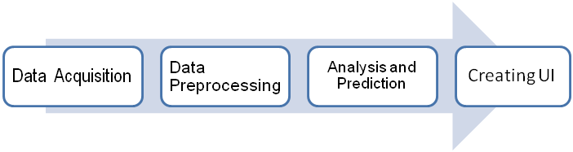
Work Flow
Four steps in the flow:

Slide 7
Steps
Data Acquisition: A dataset was acquired from kaggle which had columns like store(warehouse number), , holiday, markdown sales(sales during different holidays), month, size of the store and temperature of the region and it was used with minor modification for the project.
Data Preprocessing: Data preprocessing is an essential step in order to increase the accuracy of machine learning models. It involves handling inaccurate and missing data, noisy data in the form of outliers, and inconsistent data in the form of duplication and others.
Data Cleaning: Data was often not consistent; missing values or values out of range was common. The methods used for cleaning is to replace the missing or noisy values by forward filling them using mean of the feature.
Analysis: Some of the Regression based algorithms that have been used to analyze and make predictions are:
1. Extra Trees Regression 2. Random Forest Regression
3. K-Neighbours Regression

Slide 8
Steps followed for prediction using the best Model
K - fold cross validation is applied to select the best model for training and testing the data then and it came out to be Random Forest Regressor.
1) Select random samples from a given dataset.
2) Construct a decision tree for each sample and get a prediction result from each decision tree.
3) Perform a vote for each predicted result.
4) Select the prediction result with the most votes as the final prediction.

Slide 9
Advantages of the application
Minimize errors, delays, and disruptions – With the proper processes and technologies in place, one should be able to automate and streamline warehouse operations to avoid costly delays and reduce human and system errors.
Maximize productivity – Establishing and maintaining an efficient flow of inbound and outbound activity throughout warehouse will increase the overall quantity of products, company can process and improve the speed at which you can ship them to customers.
Provide supply chain visibility – The more visibility vendors, and logistics partners have into the receiving, packaging, labeling, and shipping methods, the more smoothly operations will run.
Ensure compliance and security – The phrase “safety first” is especially important in warehouses, which require workers to operate heavy machinery. It is needed to make sure one is operating in compliance with various supply chain vendors and partners to prevent any unnecessary roadblocks.

Slide 10
SCREENSHOTS

Slide 11
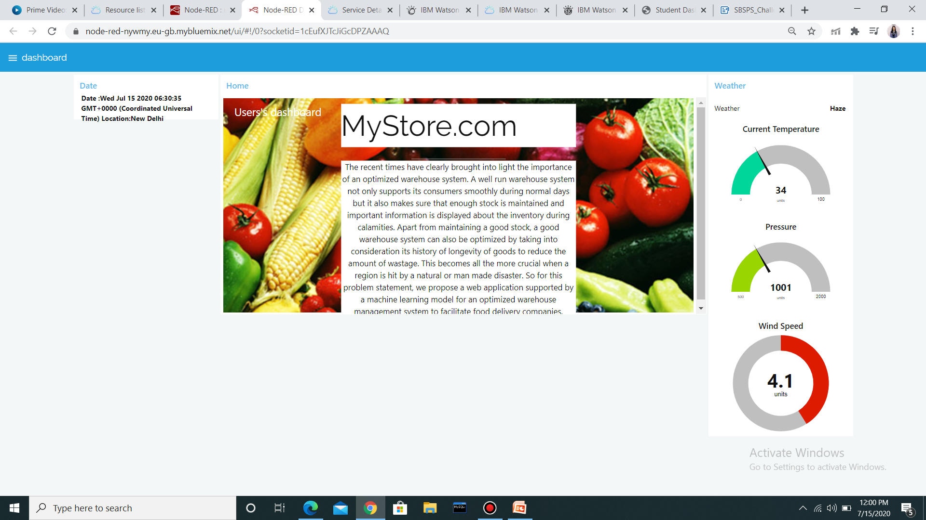
DASHBOARD

Slide 12
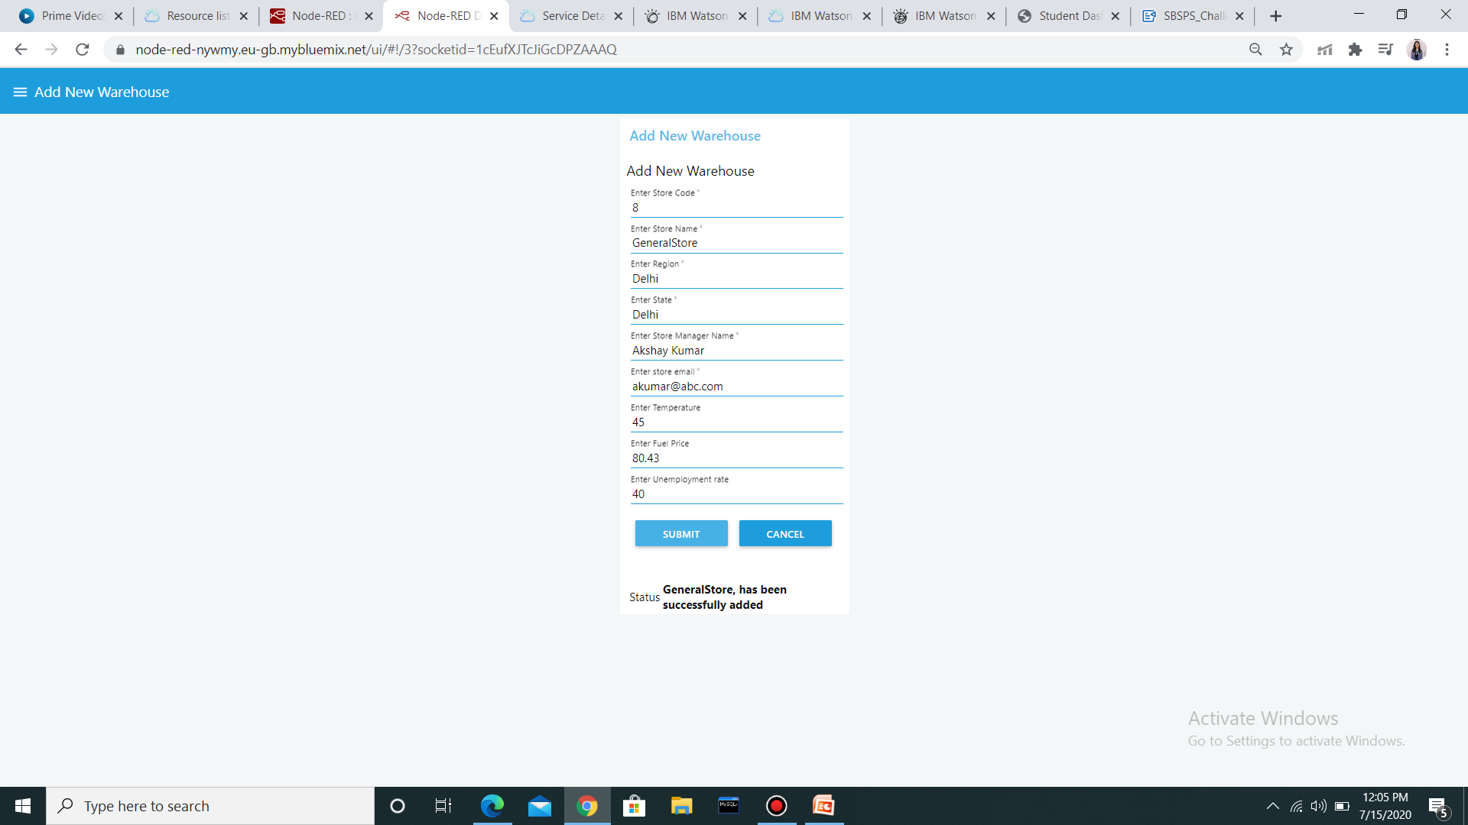
ADD NEW WAREHOUSE

Slide 13
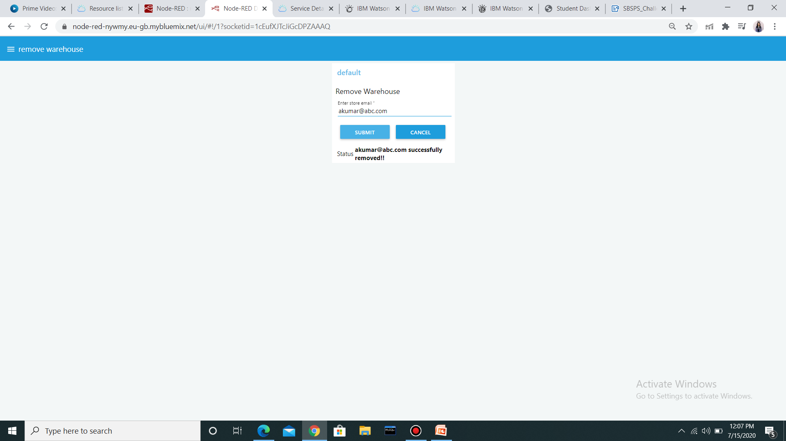
REMOVE WAREHOUSE

Slide 14
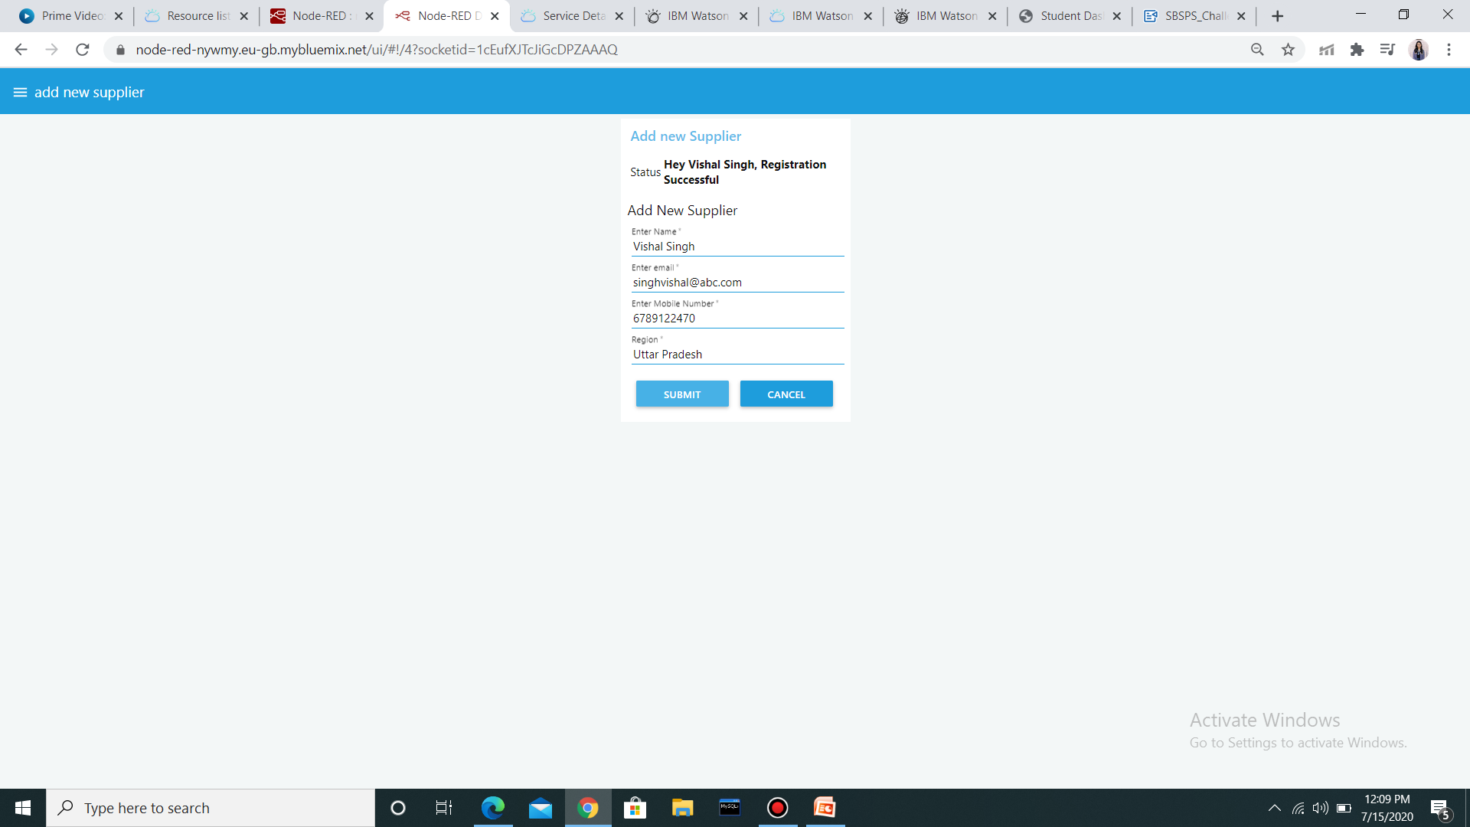
ADD NEW SUPPLIER

Slide 15
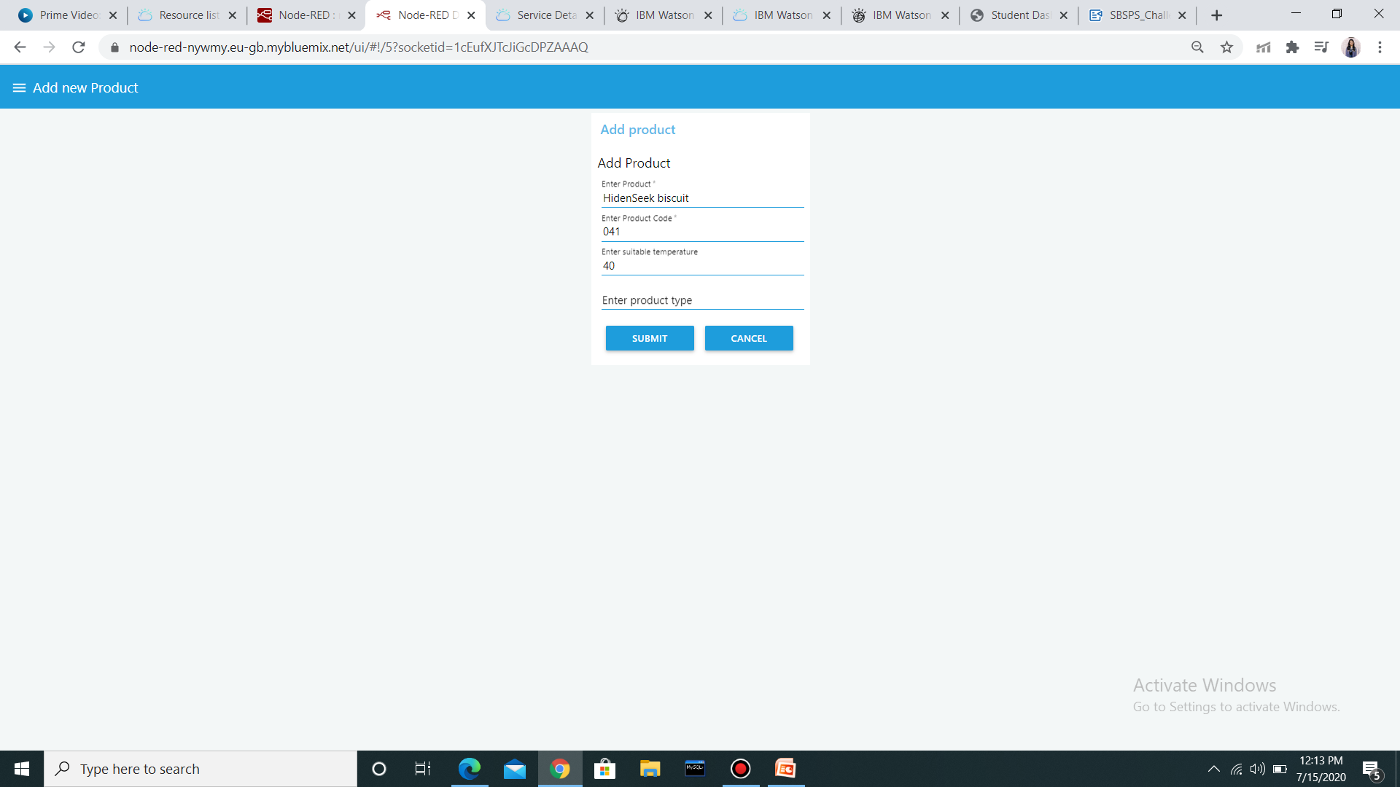
ADD NEW PRODUCT

Slide 16
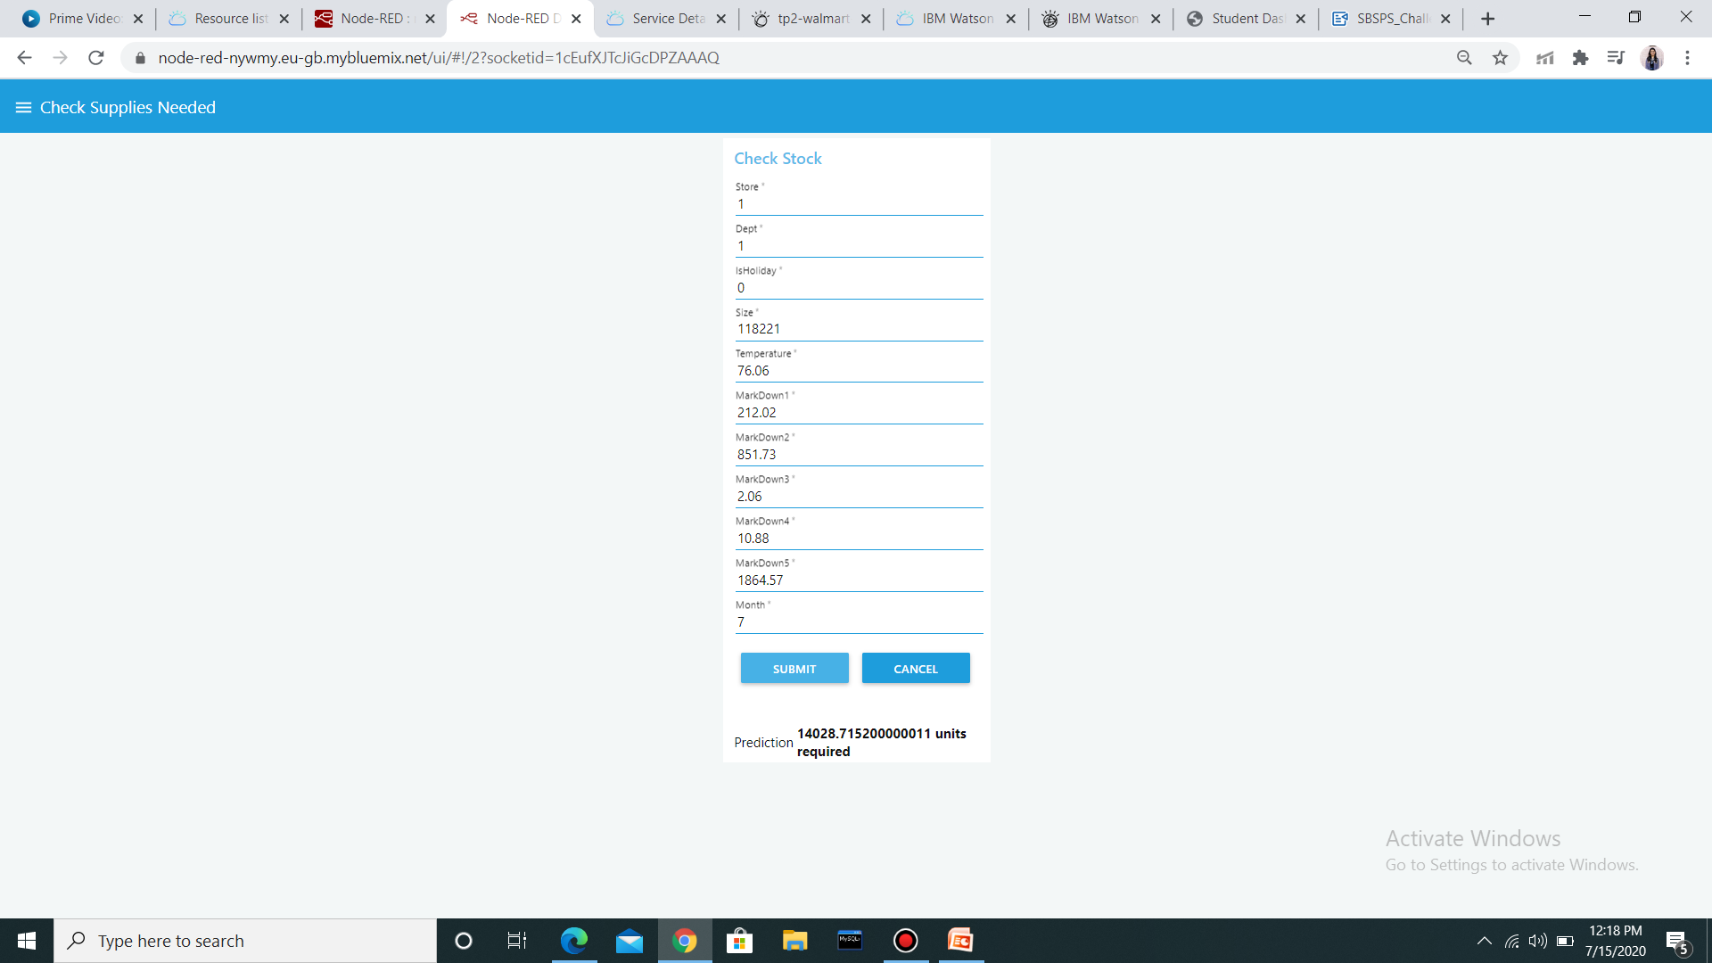
CHECK SUPPLIES NEEDED

Slide 17
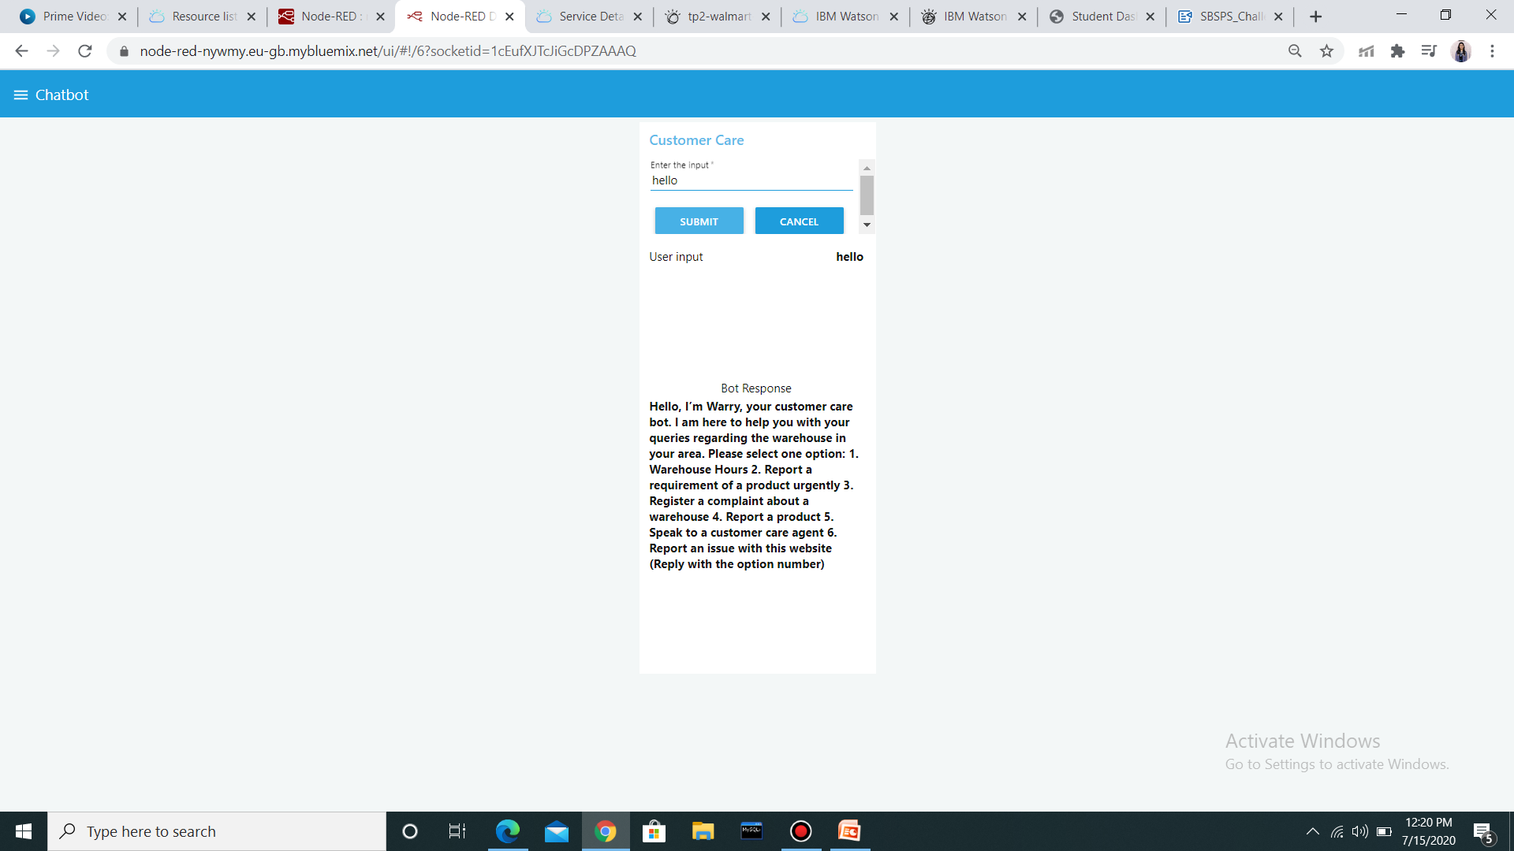
CHATBOT

Slide 18
Conclusion
The solution can help the food vending companies to handle the warehouses in a more efficient way by considering the holidays, temperature, weather conditions that can affect the stock of perishable goods and refill their stocks as and when needed.
The model can predict the need of order 10 weeks before the stocks end. This way, its an efficient application where one can maintain all the records and predict the orders needed.

Slide 19
THANK YOU!!

